Slide 1




Unveiling the Secrets of Neutron Stars – X-ray Astronomy
Derrick Drango
College of Engineering
Dr. Pradhan (Mentor)

Slide 2



Introduction
Currently 1 person team
X-ray spectroscopy of neutron stars
Work with mentor to review and analyze data

Slide 3
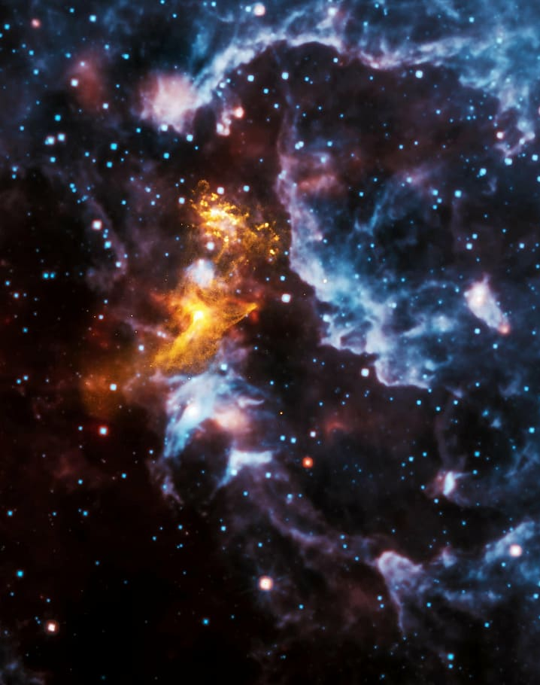
Neutron Star
Extremely dense remnants of massive stars that have exploded in supernovae
Low mass x-ray Binary systems (LMXB)
binary star system consisting of a compact object and a low-mass companion star
Types - NASA Science. (n.d.). Science.nasa.gov. & Low-mass X-ray Binaries | COSMOS. (n.d.). Retrieved March 31, 2024

Slide 4
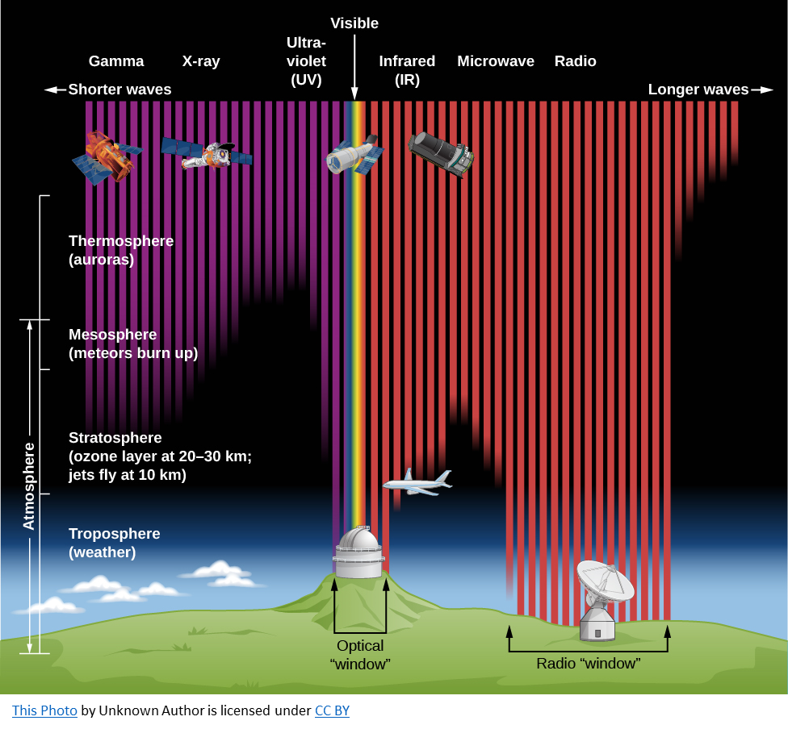
What is X-Ray astronomy
Astronomers use x-ray telescopes to observe x-rays from stellar objects.
X-ray telescopes can only be in space
They can observe one source for days at a time
Types - NASA Science. (n.d.). Science.nasa.gov. &

Slide 5
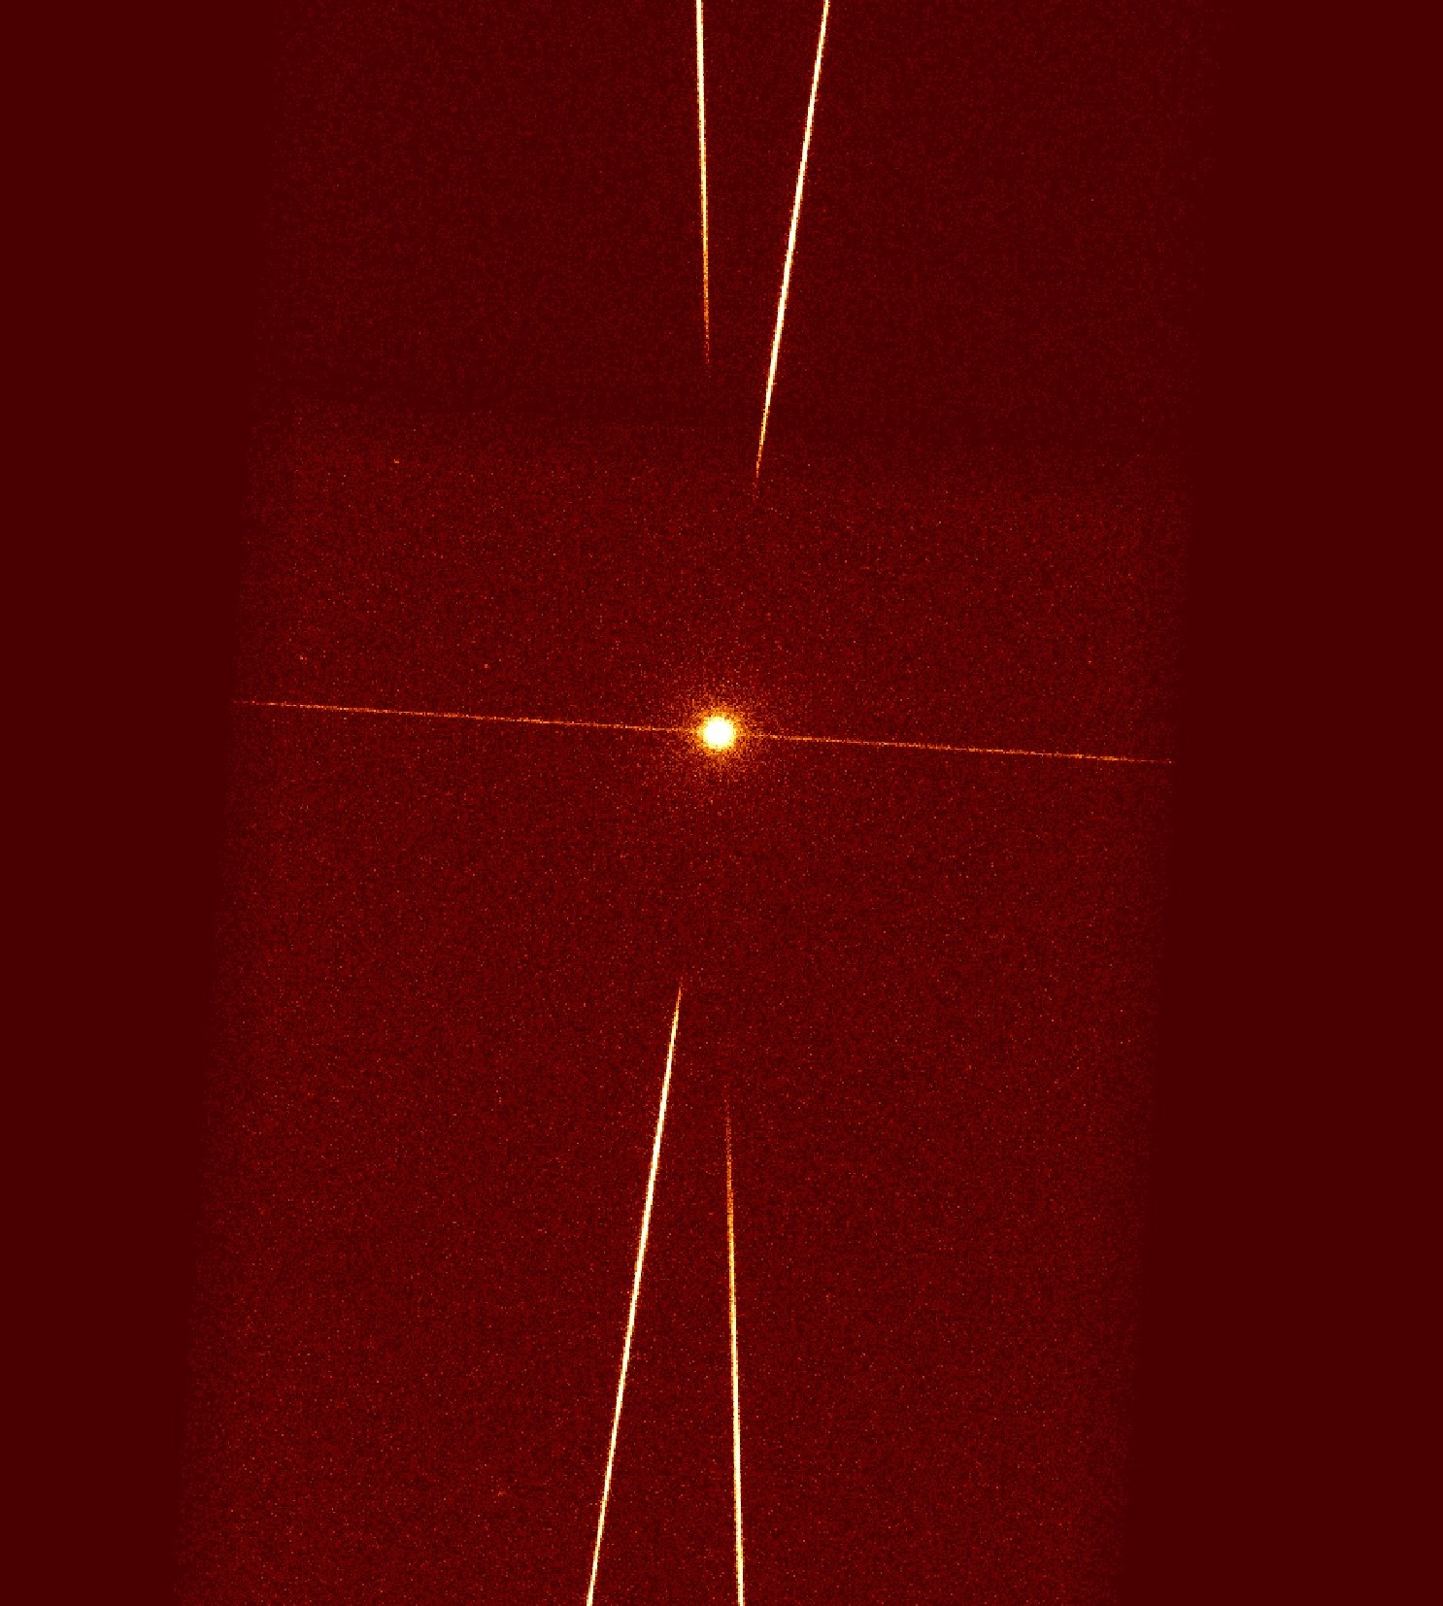
Objectives
To analyze x-ray emissions from LMXB EXO 0748-676
To understand the physical properties and behavior of EXO 0748-676

Slide 6
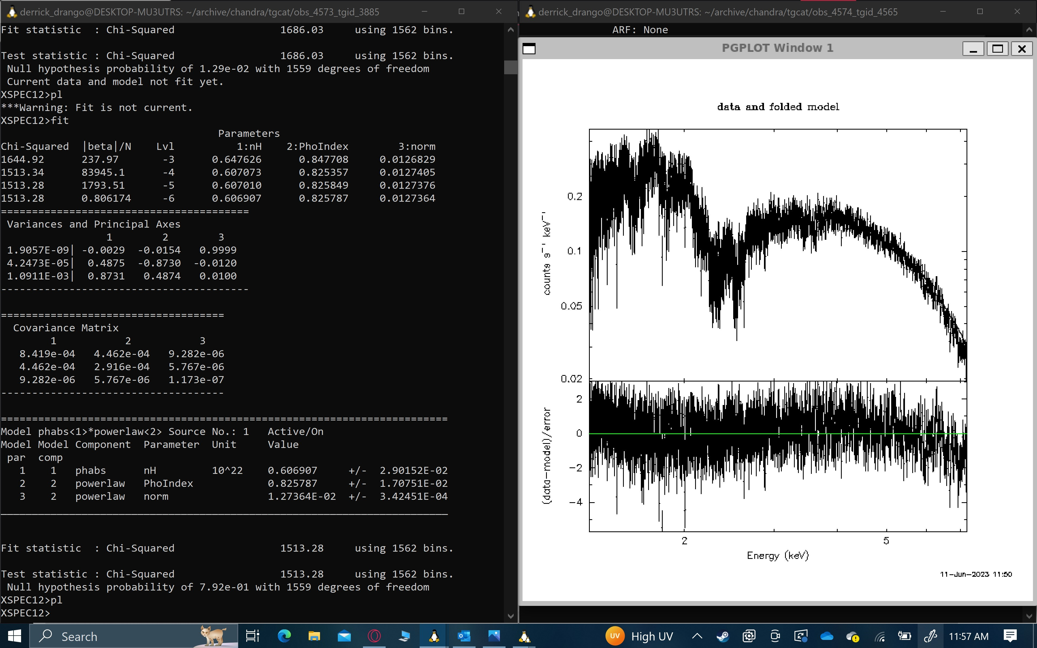
How I Use X-ray astronomy for my research
Data:
NuStar, Chandra, and Nicer telescope.
Software:
Linux including X-spec, Ciao, etc.
Chandra X-ray Observatory - NASA’s flagship X-ray telescope. (2019).

Slide 7
Discussion
Interpretation of Results
Future Directions
Telescope limitations
X-ray data correction
Challenges and uncertainties in X-ray analysis
Software
Physics
Potential avenues for further research
Future use of data in published paper
Chandra X-ray Observatory - NASA’s flagship X-ray telescope. (2019).

Slide 8
References
Chandra X-ray Observatory - NASA’s flagship X-ray telescope. (2019). https://www-xray.ast.cam.ac.uk/xray_introduction/
Introduction to X-ray Astronomy. (n.d.). https://www-xray.ast.cam.ac.uk/ https://chandra.harvard.edu/
Low-mass X-ray Binaries | COSMOS. (n.d.). Retrieved March 31, 2024, from https://www.astronomy.swin.edu.au/cosmos/L/Low-mass+X-ray+Binaries
Types - NASA Science. (n.d.). Science.nasa.gov. https://science.nasa.gov/universe/stars/types/
Supported in part through the Arizona NASA Space Grant Consortium, Cooperative Agreement 80NSSC20M0041.

